Slide 1

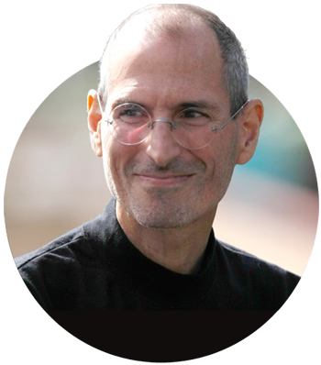






















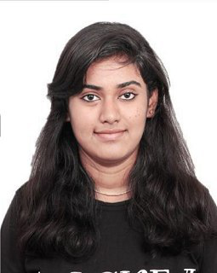
“People don’t know what they want until you show it to them”
(Steve Jobs, 1955-2011)
WATERFALL (TRADITIONAL)
Customer Satisfaction
Project Management Metaphor
Reflect & Adjust
a.k.a
Plan-Driven
Self-Organizing Teams
Welcoming Change
Build around paradigm of process
DEFINED PROCESS CONTROL MODEL
Maintain Simplicity
12
THE
Deliver Frequently
All work is understood before execution
Given a well-defined set of inputs, the same outputs are generated every time
Follow the pre-determined steps to get known results
AGILE
AGILE
Continuous Attention
Work Together
a.k.a
Change-Driven
PRINCIPLES
Build around paradigm of change/adaptation
EMPIRICAL (ADAPTIVE) PROCESS CONTROL MODEL
Sustainable Development
Trust & Support
Frequent inspection and adaptation occurs as work proceeds
Processes are accepted as imperfectly defined
Outputs are often unpredictable and unrepeatable
Working Software
Face-to-Face Conversation
AGILE IS ABOUT DELIVERING “BEST POSSIBLE VALUE” NOT MAXIMUM POSSIBLE VALUE
Sukeerti J Nandihal
That’s why most Agile approaches define Project Vision
Focusing on value delivery not on fixed product definition or strict adherence to plan
Agile is about focusing on business value/outcome, not strictly project plan/output
Contact Me: sukeerti.jnandihal@atos.net

